Slide 1
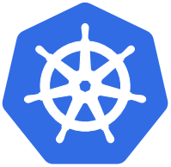
Kubernetes
By: Ankit Yadav
Preetam Jain
Ritu Agrawal

Slide 2
Presentation Agenda
Introduction
Need for Kubernetes
Features
Docker Swarm vs Kubernetes
Architecture
Facts and Figures
Cloud Providers for Kubernetes
Use Case

Slide 3
Introduction
Kubernetes is quickly becoming the new standard for deploying and managing software in the cloud. Kubernetes is an open-source container management (orchestration) tool. It’s container management responsibilities include container deployment, scaling & descaling of containers & container load balancing.
Note: Kubernetes is not a containerization platform. It is a multi-container management solution. For containerization we can use Docker, Linux etc.

Slide 4
Why do we need Kubernetes?
The areas of concern that lead to Kubernetes being needed are-
Containers could not communicate with each other.
Containers had to be deployed appropriately.
Containers had to be managed carefully.
Autoscaling was not possible
Distributing traffic was still challenging

Slide 5

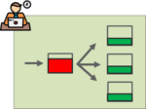
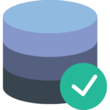
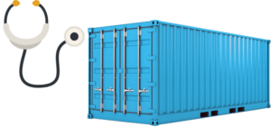
Features
Automatic Binpacking
Service Discovery & Load balancing
Storage Orchestration
Self-Healing

Slide 6
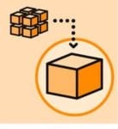
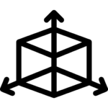

Feature
5. Batch Execution
6. Horizontal Scaling
7. Automatic Rollbacks & Rollouts

Slide 7
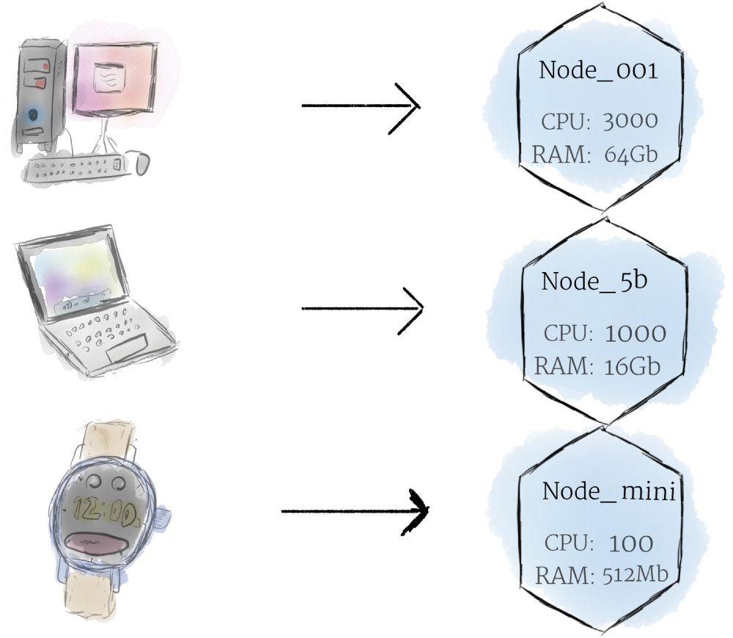
Kubernetes Architecture-
Hardware
Nodes:
Smallest unit of computing Hardware
Single machine in cluster
Physical or virtual one on cloud

Slide 8
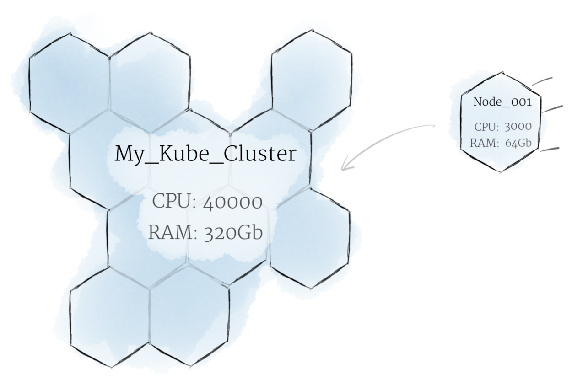
Hardware
The Cluster:
Nodes pool together
Kubernetes handles distribution of work to node
Hivemind-like system-Like Borg from Star Trek,
“Borg” is the name for the internal Google project Kubernetes was based on.

Slide 9
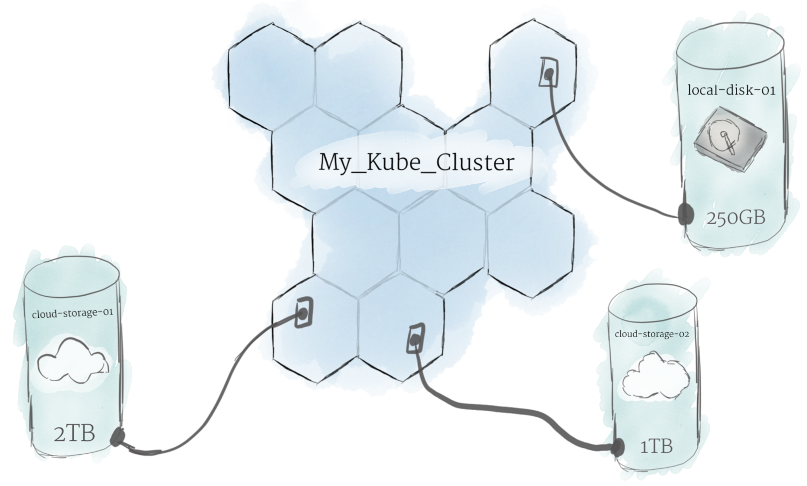
Hardware
Persistent Volumes:
Local Storage of node → Cache
To store data permanently → Persistent Volumes.
CPU and RAM of nodes are used in cluster
PV is like plugging an external hard drive.

Slide 10
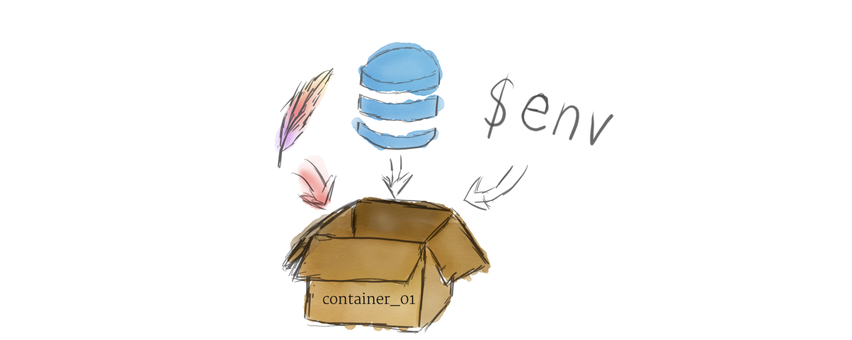
Software
Containers:
Program running on linux environments
Program with all its dependencies in single file

Slide 11
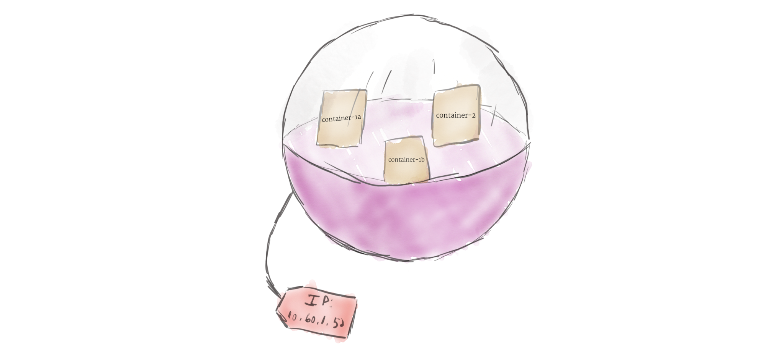
Software
Pods:
One or more containers wrap to form pod.
Multiple copies running
Load balancing

Slide 12
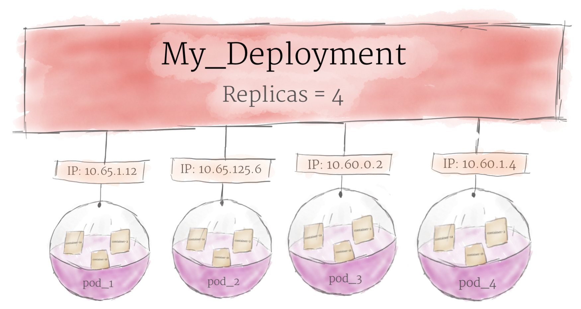
Deployment
Pods are not launched on cluster. One more layer of abstraction: Deployment
Purpose:
Monitor no of replicas of pods
Spin up required number of pods
Recreate if pod dies
No manual dealing of pods
Declare desired state and leave rest to Deployment

Slide 13
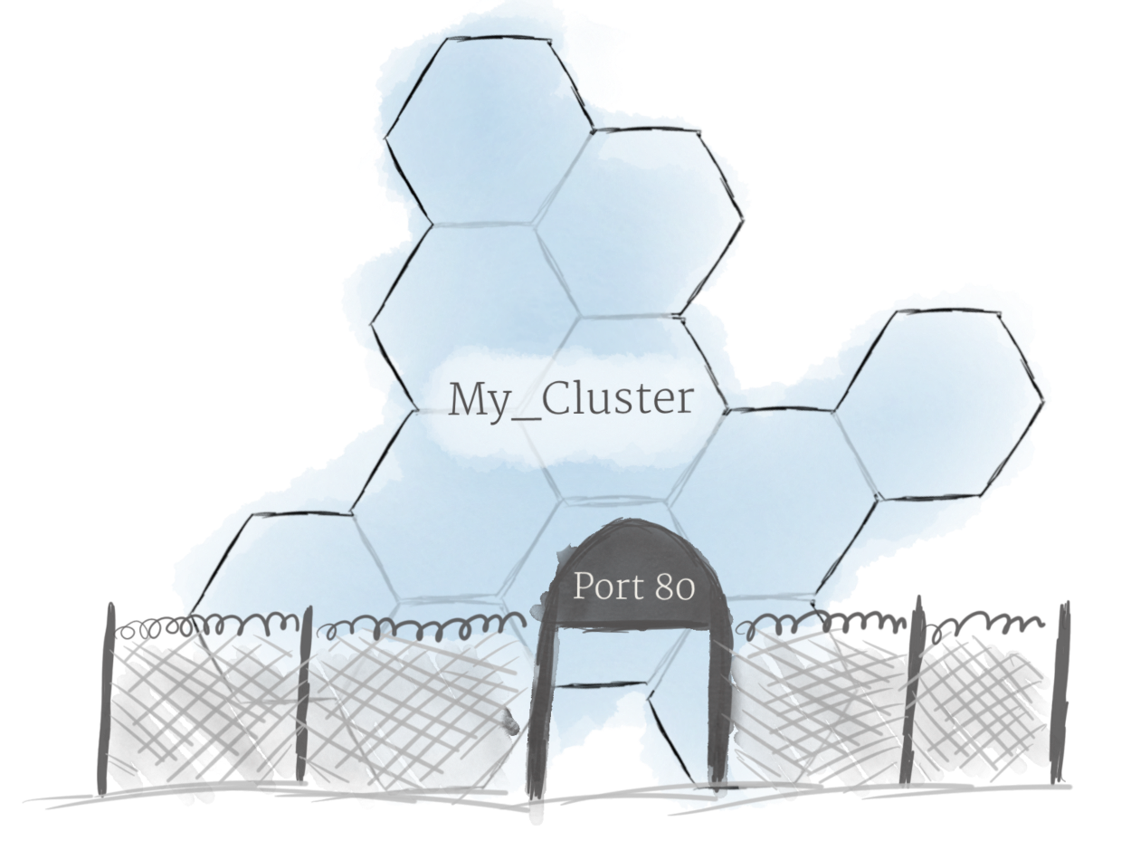
Deployment:
Ingress:
Done: Creation of cluster and deployed pods on them
Problem: Allowing external traffic.
By default, Kubernetes provides isolation between pods and the outside world.
Solution: Opening a communication channel is Ingress
Implementation: Ingress Controller, Loadbalancer etc

Slide 14
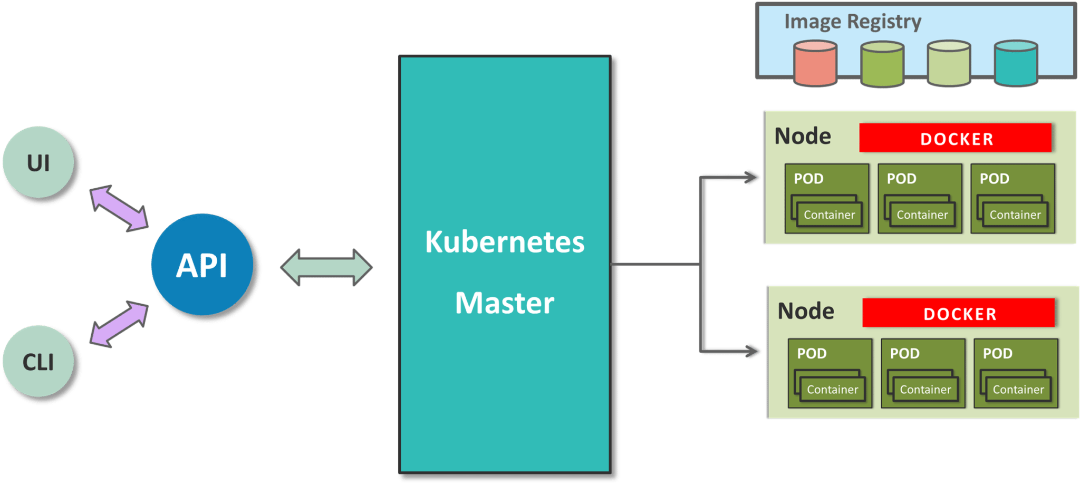
Since Kubernetes implements a cluster computing background, everything works from inside a Kubernetes Cluster. This cluster is hosted by one node acting as the ‘master’ of the cluster, and other nodes as ‘nodes’ which do the actual ‘containerization‘. Below is a diagram showing the same.

Slide 15
Kubernetes vs Docker Swarm
Pros of Kubernetes
Based on extensive experience running Linux containers at Google. Deployed at scale more often among organizations. Kubernetes is also backed by enterprise offerings from both Google (GKE) and RedHat (OpenShift). Can overcome constraints of Docker and Docker API. Autoscaling based on factors such as CPU utilization. Largest community among container orchestration tools. Over 50,000 commits and 1200 contributors. | Does not have as much experience with production deployments at scale. Limited to the Docker API’s capabilities. Services can be scaled manually. Smaller community and project. Over 3,000 commits and 160 contributors.

Slide 16
Cons of Kubernetes
Do-it-yourself installation can be complex, but flexible. Deployment tools include kubeadm, kops, kargo, and others. Further details in Kubernetes Deployment Guide. Uses a separate set of tools for management, including kubectl CLI. | Deployment is simpler and Swarm mode is included in Docker Engine. Integrates with Docker Compose and Docker CLI – native Docker tools. Many of the Docker CLI commands will work with Swarm. Easier learning curve.

Slide 17
Common Features
Open source projects. Anyone can contribute using the Go programming language. Various storage options. Networking features such as load balancing and DNS. Logging and Monitoring add-ons. These external tools include Elasticsearch/Kibana (ELK), sysdig, cAdvisor, Heapster/Grafana/InfluxDB. Logging and Monitoring for Kubernetes Logging and Monitoring for Docker Swarm

Slide 18
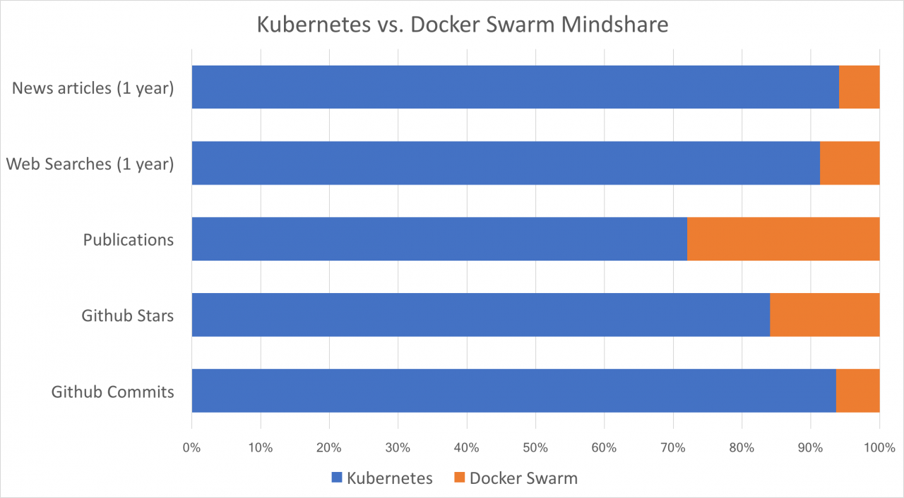
Takeaways
Kubernetes has been deployed more widely than Docker Swarm, and is validated by Google.
Kubernetes leads on all metrics: when compared with Docker Swarm, Kubernetes has over 80% of the mindshare for news articles, Github popularity, and web searches.
However, there is general consensus that Kubernetes is also more complex to deploy and manage.
The Kubernetes community has tried to mitigate this drawback by offering a variety of deployment options, including Minikube and kubeadm.

Slide 19
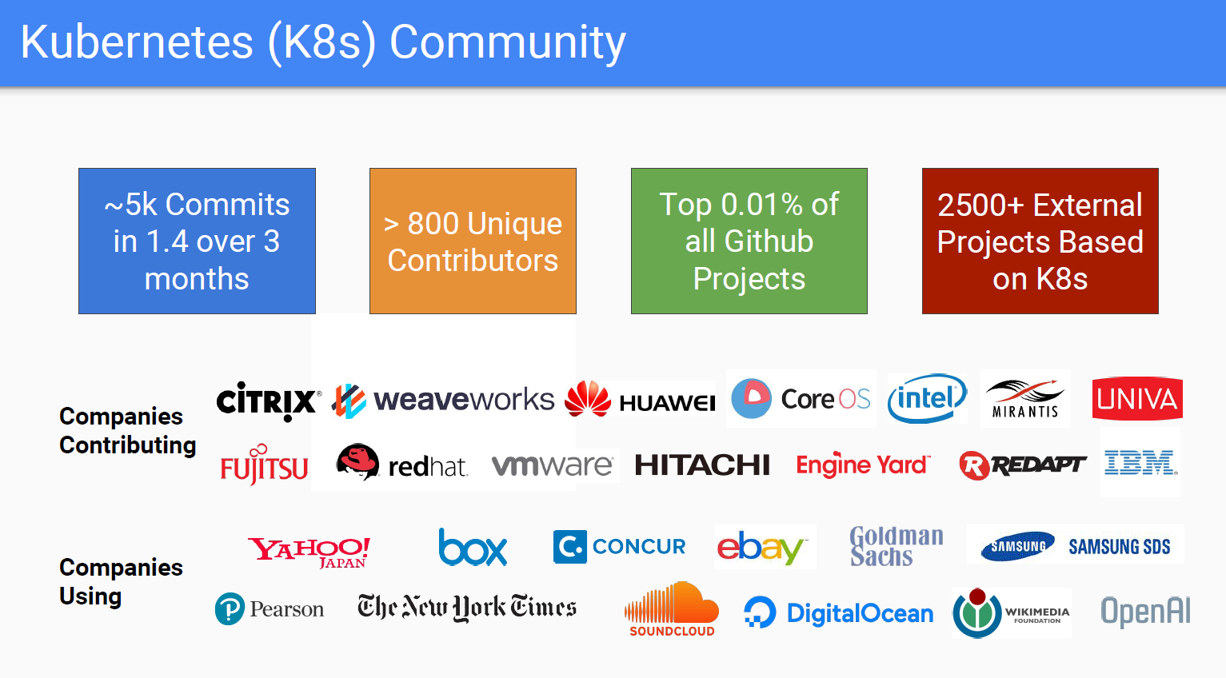

Slide 20
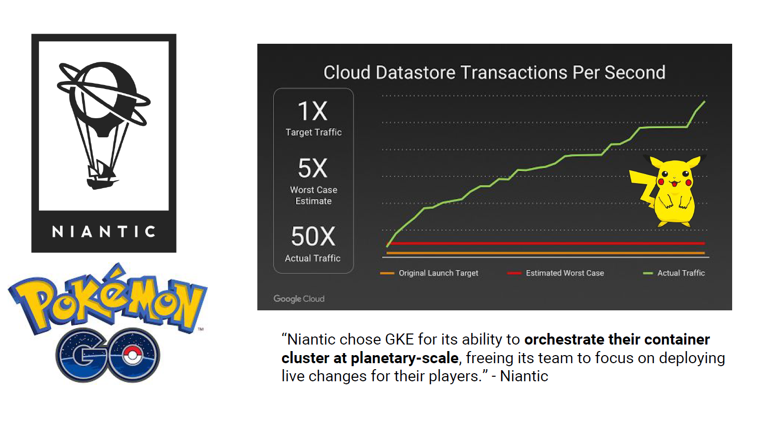

Slide 21
Cloud Providers for Kubernetes
AWS
Azure
CloudStack
GCE
OpenStack
OVirt
Photon
VSphere
IBM Cloud Kubernetes Service

Slide 22
Kubeflow
Make it easy for everyone to develop, deploy, and manage portable, distributed ML on Kubernetes. The Kubeflow project is dedicated to making deployments of machine learning (ML) workflows on Kubernetes simple, portable and scalable. Our goal is not to recreate other services, but to provide a straightforward way to deploy best-of-breed open-source systems for ML to diverse infrastructures. Anywhere you are running Kubernetes, you should be able to run Kubeflow.

Slide 23
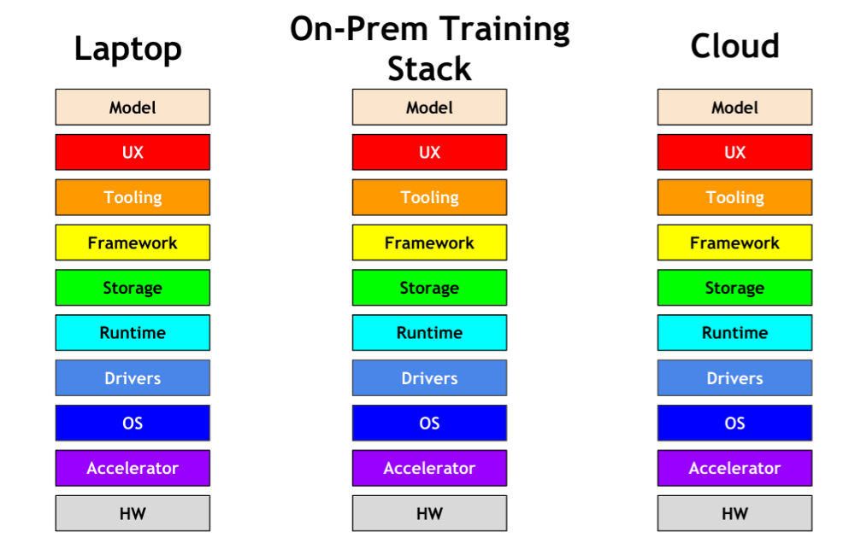
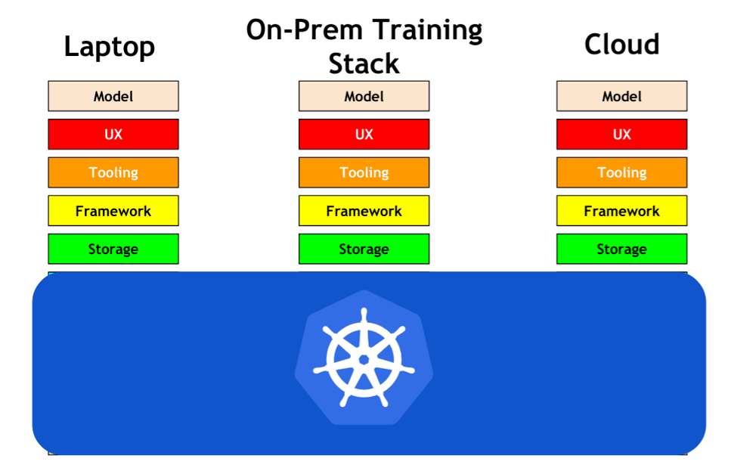
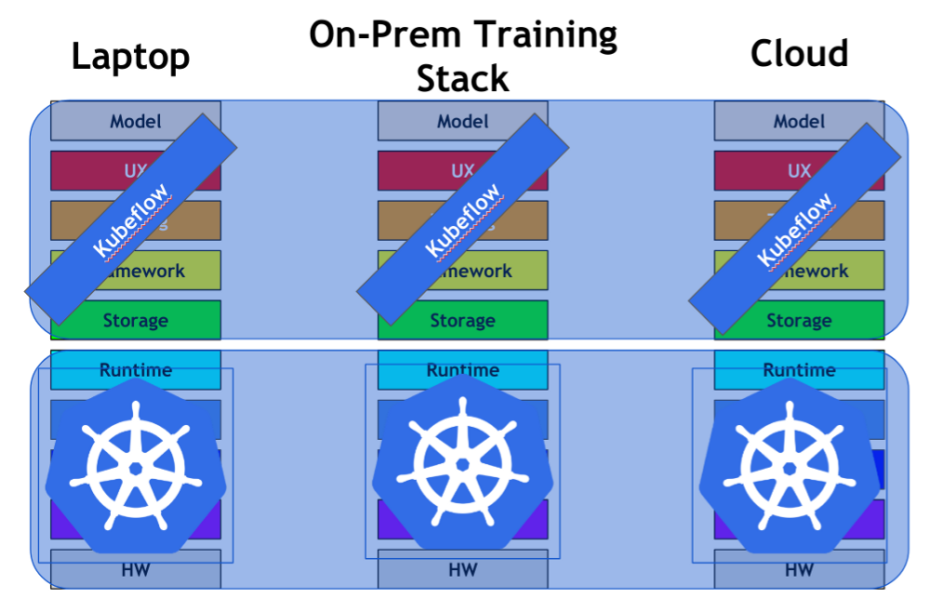

Slide 24
Helm- The Package Manager for Kubernetes
Helm is the best way to find, share, and use software built for Kubernetes.Helm helps you manage Kubernetes applications — Helm Charts helps you define, install, and upgrade even the most complex Kubernetes application.
Charts are easy to create, version, share, and publish — so start using Helm and stop the copy-and-paste madness.
The latest version of Helm is maintained by the CNCF - in collaboration with Microsoft, Google, Bitnami and the Helm contributor community.

Slide 25
Seldon
Seldon Core
Seldon Core is an open source platform for deploying machine learning models on Kubernetes.
Goals
Allow data scientists to create models using any machine learning toolkit or programming language.
Expose machine learning models via REST and gRPC automatically when deployed for easy integration into business apps that need predictions.
Allow complex runtime inference graphs to be deployed as microservices. These graphs can be composed of:
Models - runtime inference executable for machine learning models
Routers - route API requests to sub-graphs. Examples: AB Tests, Multi-Armed Bandits.
Combiners - combine the responses from sub-graphs. Examples: ensembles of models
Transformers - transform request or responses. Example: transform feature requests.
Handle full lifecycle management of the deployed model:
Updating the runtime graph with no downtime
Scaling
Monitoring
Security

Slide 26
Thank you

